Slide 1

Server-Side Development with AI
Neon DB, Drizzle ORM, Next.js APIs with Database and Auth, Automated Testing, Serverless Deployment
Svetlin Nakov, PhD
Co-founder @ SoftUni

Slide 2
Agenda
Neon: Serverless PostgreSQL in the cloud + Neon MCP
ORM Frameworks and Drizzle: schema, queries, migrations, type-safety
Exercise: Countries and Towns console app with Neon + Drizzle
Back-End API with Next.js + Neon: API route handlers, Neon DB, JWT auth
Exercise: RESTful Blog API with Next.js + Drizzle + Neon
Blog System Client App: React front-end in the Next.js app
File Uploads with Cloudflare R2 (an S3-compatible object storage)
Automated Testing: Jest unit + integration tests, Playwright E2E
Serverless vs. Server-based Deployment: providers and trade-offs
Deploying Next.js App to Netlify: deploy from GitHub, env variables

Slide 3

Sli.do Code
# AppsAI

Slide 4

Breaks
20:00 / 21:00

Slide 5

Neon DB: Serverless PostgreSQL
Neon: PostgreSQL DB in the Cloud, Scale-to-Zero, SQL Editor, Neon MCP

Slide 6

What is Neon?
Neon == serverless PostgreSQL in the cloud
Neon separates compute from storage: attach DB storage to DB compute on demand
What is a serverless database?
Suspends compute after 5 min idle → resumes on next query
Cold query starts in ~600 ms (wake up)
See Neon Latency Benchmarks: https://neon.com/demos/regional-latency
Generous free tier, great for learning:
100 free projects, 0.5 GB storage / project, 3 compute hours / day

Slide 7
Why Serverless Postgres?
🗄️ Traditional PostgreSQL
Always-on server – pay 24/7
Manual scaling – adjust resources yourself (CPU, RAM)
Provisioning – slow startup times
Backups & patching – handled manually
One DB = one VM – tightly coupled resources
Branching / cloning – hard to manage
⚡ Serverless PostgreSQL (Neon)
Pay for what you use – scale-to-zero when idle / auto-scale
Provisioning – databases spin up in milliseconds
Managed infrastructure: auto patches, maintenance, backups
Instant branching – like Git for databases
Perfect match for serverless apps (Vercel, Netlify)

Slide 8
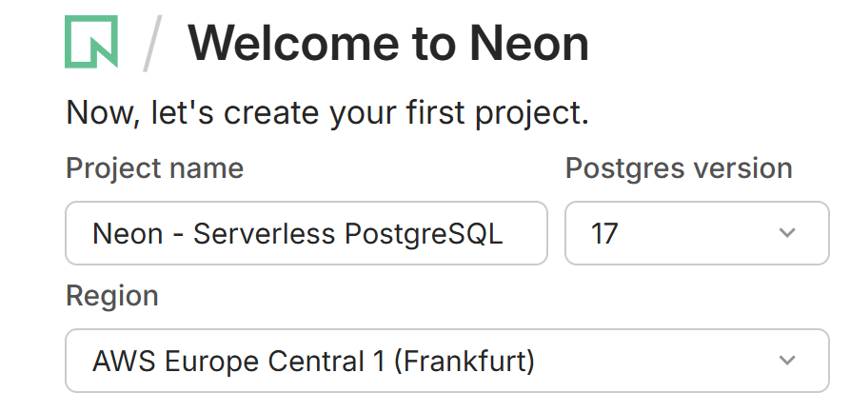
Creating a Neon Database
Sign up at https://neon.com (GitHub / Google login)
Create a project → pick region + PostgreSQL version
Neon auto-creates:
Default database (neondb)
Default branch (production)
Pooled + unpooled connection strings
Copy DATABASE_URL → paste in the app's .env file

Slide 9
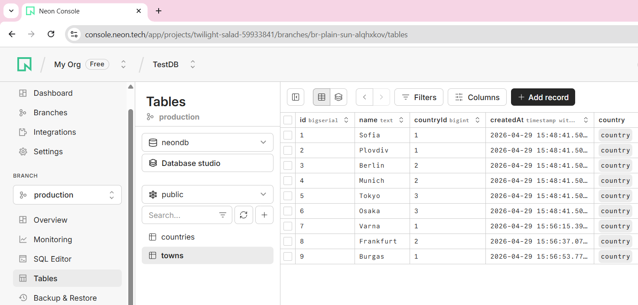
Neon Table Editor

Slide 10
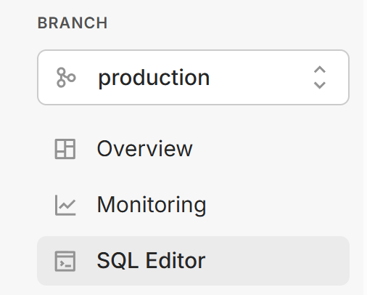
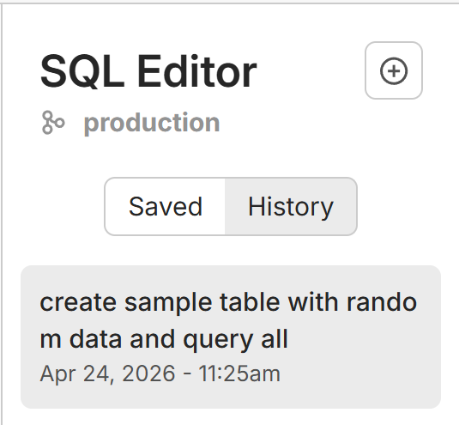
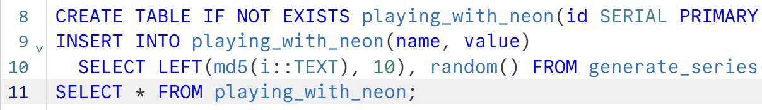
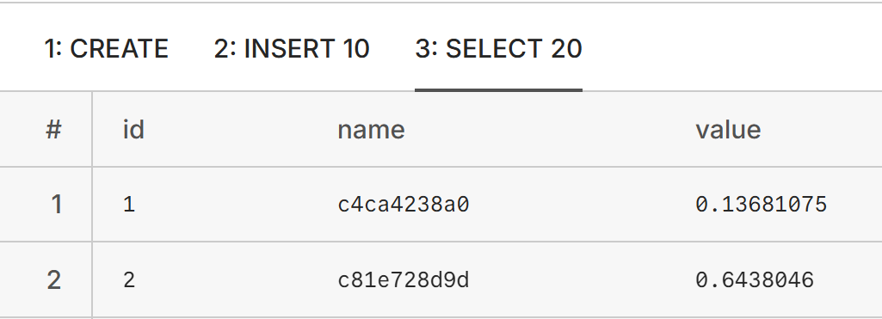
Neon SQL Editor
Built-in SQL editor in the Neon console
Run arbitrary SQL: CREATE TABLE, INSERT, SELECT, …
Visual table browser: columns, rows, relations
Query history, compute usage, storage usage
Branching: create a throw-away branch for experiments

Slide 11
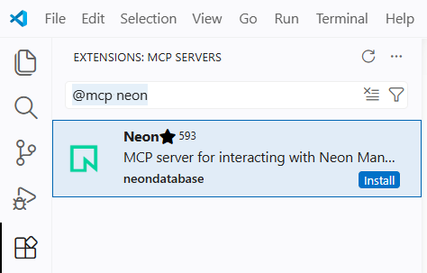
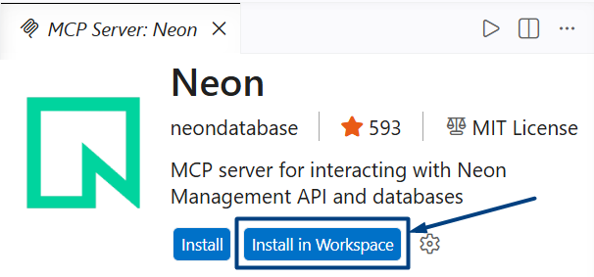
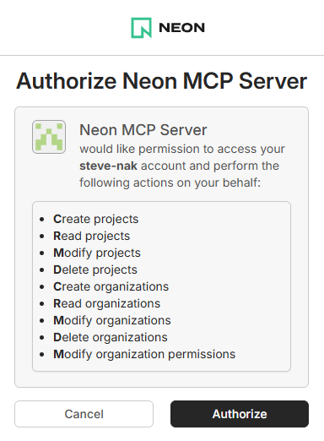
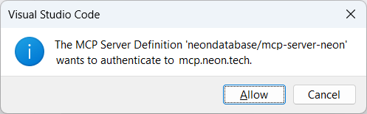
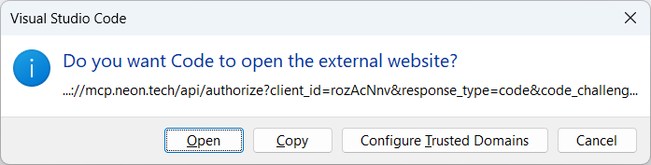
Connecting Neon MCP in VS Code
MCP == Model Context Protocol
Enables AI agents (Copilot, Claude) to talk directly to your Neon DB
Install Neon CLI + MCP in VS Code
VS Code → Extensions → Search `@mcp neon` → Install in Workspace → Connect Neon DB account

Slide 12
Neon MCP in VS Code
Note: Neon MCP connects to your entire Neon account (all projects), not to certain Neon project
AI dev agents using Neon MCP see all projects in your Neon account
You should tell which Neon DB to use explicitly
Best practice: define your Neon DB name in AGENTS.md
AGENTS.md
# Neon MCP Database Access Rules
- Connect Neon MCP only to a database project named `CountriesDB` in my Neon account

Slide 13
Playing with the Neon MCP
🤖 AI prompts you can use right away:
Neon MCP → the AI has direct DB access
No need to copy-paste SQL around anymore
👉 Try these example prompts
#1 Create DB tables: `countries` (id, name, createdAt) and `towns` (id, name, countryId, createdAt)
#2 Show all tables in the database + their columns
#3 Insert a few sample countries + towns in the DB
#3 Count the rows in every table in the DB

Slide 14
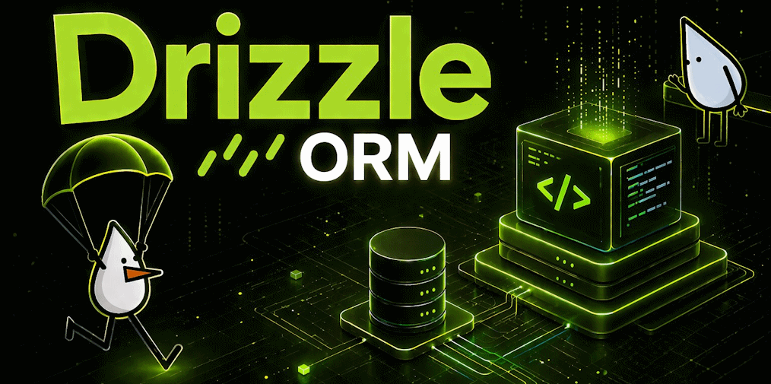
ORM Frameworks and Drizzle
ORM Frameworks, Drizzle ORM, Schema, Queries, Migrations, DB Operations

Slide 15
What is an ORM?
ORM framework == Object-Relational Mapper
Connects your code with DB
Maps DB tables ↔ TypeScript objects
Provides DB access API
Benefits of ORMs:
Less boilerplate code
Safe from SQL-injection
Built-in migrations
// Raw SQL approach
const rows = await sql`
SELECT * FROM users WHERE id = ${id}`;
// ORM approach
const user =
await db.select()
.from(users)
.where(eq(users.id, id));

Slide 16
Popular Node.js ORMs
💧 Drizzle
Lightweight
SQL-like API
Serverless-friendly
⚡ Prisma
Very popular
Code-first schema
Strong types
Drizzle and Prisma are the modern JS ORMs
Best for AI-first development
🏛️ TypeORM
Classic ORM
Active Record
Data Mapper
📜 Sequelize
The oldest
Very mature
Legacy-oriented
Drizzle is best for serverless apps

Slide 17
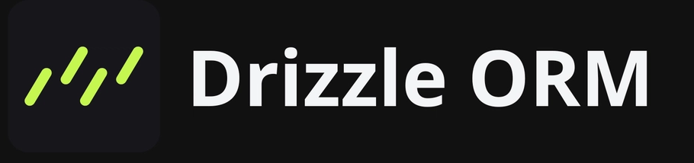
What is Drizzle ORM?
Drizzle == TypeScript-first, SQL-like ORM
https://orm.drizzle.team
Feels like SQL, but fully type-safe
Lightweight (~7 KB runtime), edge-ready
Serverless-friendly: works with Neon, Vercel, Cloudflare
Two data access APIs:
Query API: db.query.users.findMany()
Core API: db.select().from(users)

Slide 18
Installing and Connecting Drizzle
Install Drizzle + Neon driver
Connect to Neon by DB connection string
The db object is type-safe and ready to use
Works in Node, edge, and serverless
// Install Drizzle + Neon
npm install drizzle-orm @neondatabase/serverless
npm install -D drizzle-kit
// Connect to Neon
import { neon } from "@neondatabase/serverless";
import { drizzle } from "drizzle-orm/neon-http";
const neonDb = neon(
process.env.DATABASE_URL!);
export const db = drizzle(neonDb);

Slide 19
Defining a Drizzle Schema
import { pgTable, serial, text, timestamp } from "drizzle-orm/pg-core";
export const posts = pgTable("posts", {
id: serial("id").primaryKey(),
title: text("title").notNull(),
content: text("content"),
createdAt: timestamp("created_at").defaultNow(),
});
// Types inferred automatically
type Post = typeof posts.$inferSelect;
type NewPost = typeof posts.$inferInsert;

Slide 20
Drizzle Migrations
Migration == versioned change to the DB schema
Generate migrations from schema changes (auto)
Migrate – apply pending migrations to DB
Push – dev only, change history is not preserved
Files in /drizzle, committed to Git
# Generate migration from schema
npx drizzle-kit generate
# Apply pending migrations to DB
npx drizzle-kit migrate
# Push schema directly to DB (dev only)
npx drizzle-kit push

Slide 21
DB Operations with Drizzle: SQL-Style
// Select all rows from a table
let allPosts = await db.select().from(posts);
// Select rows by filter
let post = await db.select().from(posts).where(eq(posts.id, 1));
// Insert a new row in a DB table
let newPost: NewPost = { title: "Hello", content: "World" }; await db.insert(posts).values(newPost);
// Update a row by ID
await db.update(posts).set({ title: "Updated title" }) .where(eq(posts.id, 1));

Slide 22
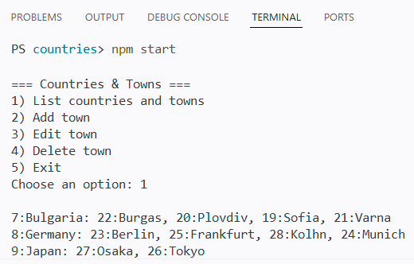
Exercise: Countries and Towns
Console App + Neon DB + Drizzle ORM + Migrations + Seed Data

Slide 23
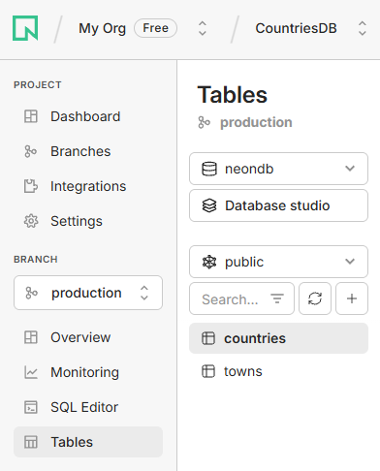
Console App: Countries and Towns
We want to build a simple console app:
Manage countries holding towns
View / add / edit / delete countries + towns
Use Node.js + Neon DB + Drizzle ORM
Database tables in Neon DB:
countries (id, name)
towns (id, name, countryId → countries.id)
Use Neon MCP to handle interactions with the database

Slide 24
Implementing the App
Sample steps to build the app:
Create Neon DB, connect Neon MCP, define AGENTS.md
Install and configure Drizzle ORM + DB connection
Create DB schema (Drizzle migration)
Seed sample data (Node.js script)
3 countries + 5-10 towns each
Implement app logic:
Print all countries with their towns
Add / edit / delete towns

Slide 25
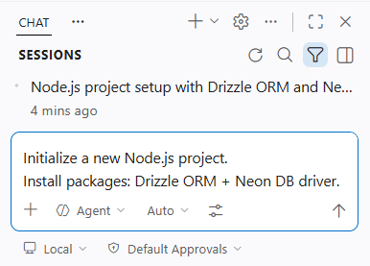
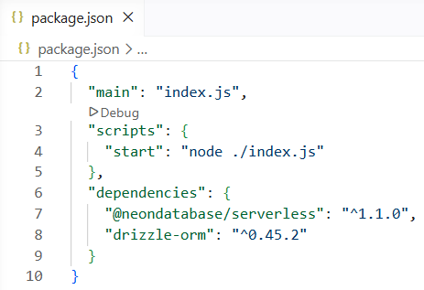
Step 1: Create VS Code Project
🤖 Use AI prompt:
Initialize a new Node.js project.
Install packages: Drizzle ORM + Neon DB driver.
🖥️ Or Terminal commands:
npm init -y
npm install drizzle-orm @neondatabase/serverless

Slide 26
Step 2: Install Neon MCP
Install Neon MCP in VS Code:
VS Code → Extensions → Search `@mcp neon` → Install in Workspace → Connect Neon DB account

Slide 27
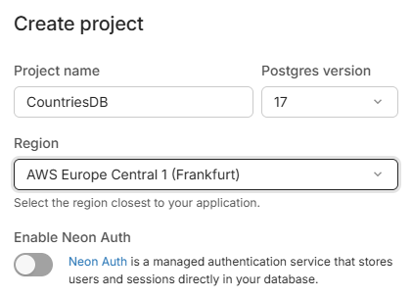
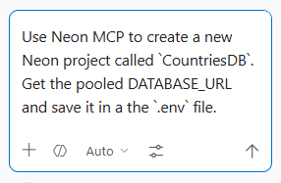
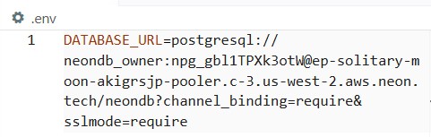
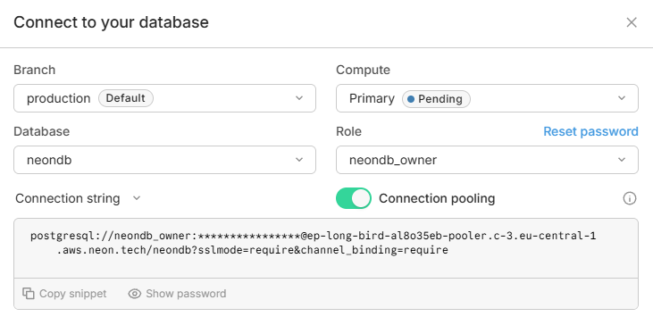
Step 3: Create the Neon DB
🤖 Create Neon DB with an AI prompt:
Use Neon MCP to create a new Neon project called `CountriesDB`.
Get the DATABASE_URL and save it in a the `.env` file.
🖥️ Or via the Neon console:
New Project → Name: CountriesDB
⚙️ Save the DB connection string to `.env` config file

Slide 28
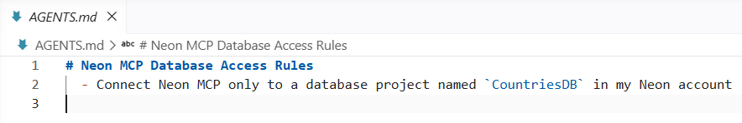
Step 4. Configure AGENTS.md
To avoid ambiguity, in AGENTS.md tell Neon MCP which database to use
AGENTS.md
# Neon MCP Database Access Rules
- Connect Neon MCP only to a database project named `CountriesDB` in my Neon account

Slide 29
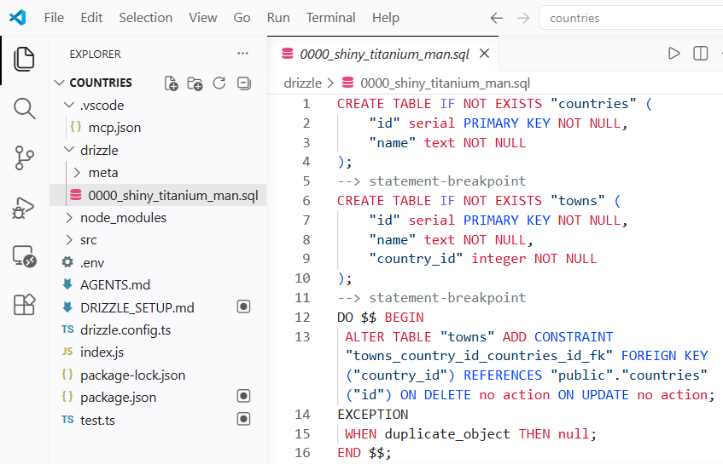
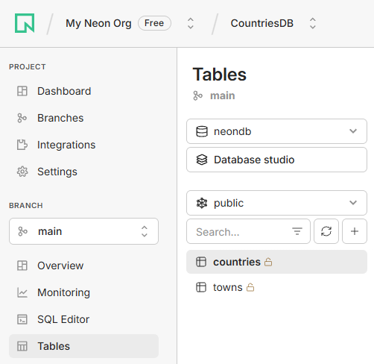
Step 5: Define DB Schema in Drizzle
🤖 AI prompt for DB tables:
Configure Drizzle with Neon DB.
Define a Drizzle schema with two tables:
- countries (id, name)
- towns (id, name, countryId → countries.id)
Generate the initial Drizzle migration and apply it to DB.
Verify tables via Neon MCP.

Slide 30
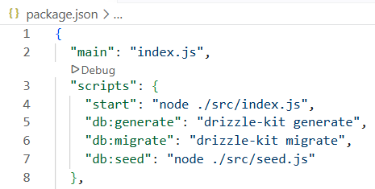
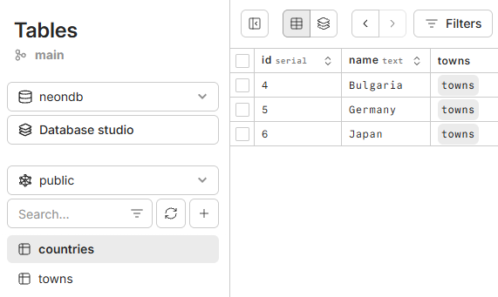
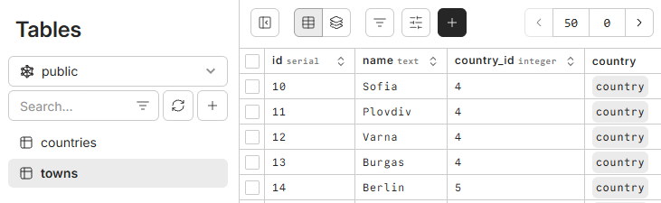
Step 6: Seed Sample Data in the DB
🤖 AI prompt to seed sample data:
Create npm script to seed the DB with sample data:
- Bulgaria: Sofia, Plovdiv, Varna, Burgas
- Germany: Berlin, Munich, Frankfurt
- Japan: Tokyo, Osaka
Run the script and confirm via Neon MCP.

Slide 31
Step 7: Implement App Logic
🤖 AI prompt to print countries + their towns:
🤖 AI prompt to add / edit / delete towns:
Implement a console app logic to print all countries with their towns:
- Bulgaria: Sofia, Plovdiv, Varna, …
- Japan: Tokyo, Osaka, …
Use Drizzle Query APIs to avoid N+1 query problem
Implement add / edit / delete town in the same console app.
Implement console-based UI with interactive menu.
Learn more about the "N+1 query problem"

Slide 32
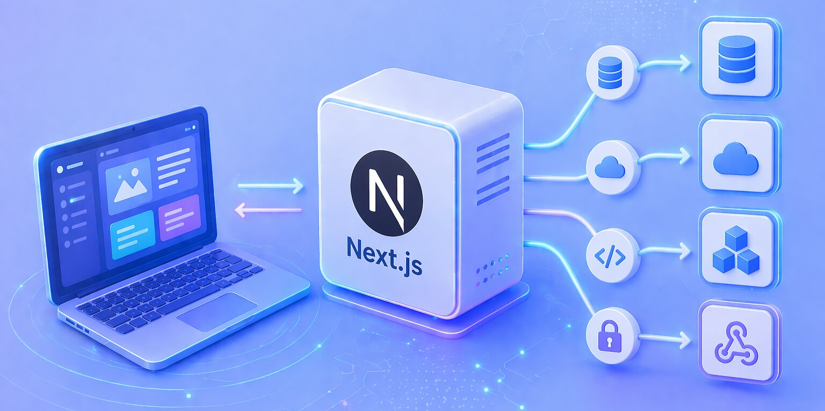
Back-End API with Next.js + Neon
API Route Handlers, Connecting Drizzle and Neon DB, Authentication with JWT

Slide 33

Why Next.js for the Backend?
Next.js == full-stack app framework, based on Node.js, TypeScript and React, by Vercel
Back-end + front-end in a single project
React UI (front-end) in /app
API handlers (back-end) in /app/api
Benefits of Next.js:
One project, one deployment
Shared types between client and server
Serverless-ready (Vercel, Netlify, Cloudflare)
Hot reload on front-end and back-end

Slide 34
Backend Architecture
Layered architecture → separation of concerns
Client → UI (calls server-side route handlers)
Route handlers → HTTP parsing, status codes
Services → business logic
DB layer → Drizzle schema + data access API
Database → run SQL
🌐 Client (React)
🔌 Route Handlers
⚙️ Services
🔗 ORM (Drizzle)
🐘 PostgreSQL (Neon)

Slide 35
Setup Drizzle + Neon DB in Next.js
Install NPM packages:
Configure DATABASE_URL in .env
Create a singleton `db` instance in lib/db.ts
Import and use `db` into yours API route handlers
import { neon } from
"@neondatabase/serverless";
import { drizzle } from
"drizzle-orm/neon-http";
import * as schema from "../db/schema";
const sql = neon(process.env.DATABASE_URL!);
export const db = drizzle(sql, { schema });
npm install drizzle-orm @neondatabase/serverless
// In API route handlers:
import { db } from "@/lib/db";
import { posts } from "@/db/schema";
// Now use db.select(), db.insert(), …

Slide 36
APIs with Next.js and Drizzle
API route handlers:
File location: /app/api/<route>/route.ts
One file per route
One exported function per HTTP method
Use NextRequest / NextResponse
import { NextRequest, NextResponse }
from "next/server";
export async function GET(req: NextRequest) {
const all = await db.select().from(posts);
return NextResponse.json(all);
}
export async function POST(req: NextRequest) {
const body = await req.json();
const [created] = await db.insert(posts)
.values(body).returning();
return NextResponse.json(created, { status: 201 });
}
/app/api/posts/route.ts

Slide 37
Dynamic API Routes
Folder name in [brackets] == URL parameter
Example path: /app/api/posts/ [id]/route.ts
Read params (async)
Query database
Return 404 for not-found resources
Return result as JSON
/app/api/posts/[id]/route.ts
export async function GET(req: NextRequest, { params }: { params: Promise<{ id: string }> }) {
const { id } = await params;
const [post] = await db.select().from(posts)
.where(eq(posts.id, Number(id)));
if (!post) return NextResponse.json(
{ error: "Not found" }, { status: 404 });
return NextResponse.json(post);
}

Slide 38

Authentication with JWT
JWT == JSON Web Token
Signed token: header.payload.signature
Stateless: no server session store
Sent via HTTP request header: Authorization: Bearer <token>
Auth flow:
User: POST /auth/login { email + password }
Server verifies → issues JWT holding `userId`
Client stores JWT (localStorage or httpOnly cookie)
Each authenticated request sends back the JWT token to the server
header
payload
signature
{
"alg": "ES256",
"typ": "JWT"
}
{
"sub": "jonny86",
"iat": 1516239022
}
KMUFsIDTnFmyG3nMiGM6H9FNFUROf3wh7S…

Slide 39
JWT Auth Logic
Small helper to verify the token:
Returns null or the token payload {userId}
Runs before the handler
In the route, check auth and return 401 if invalid
// lib/auth.ts
import jwt from "jsonwebtoken";
export function verifyToken(token: string) {
try {
return jwt.verify( token, process.env.JWT_SECRET!)
as { userId: number };
} catch { return null; }
}
verifyToken(token) → userId
// In an API route handler:
const auth = req.headers.get("authorization");
const user = auth &&
verifyToken(auth.replace("Bearer ", ""));
if (!user) return NextResponse.json(
{ error: "Unauthorized" }, { status: 401 });

Slide 40
Password Hashing with bcrypt
Never store plain-text passwords!
Always one-way encrypt passwords before saving
Use bcrypt (or argon2)
Hash with cost factor of 10–12 rounds (CPU-bound)
Verify with bcrypt.compare
import bcrypt from "bcryptjs";
// Register — hash and store to DB
const hash = await
bcrypt.hash(password, 10);
await db.insert(users).values( { email, password: hash });
// Login — verify hash from DB
const ok = await bcrypt.compare(
password, user.password);
if (!ok) return unauthorized();

Slide 41
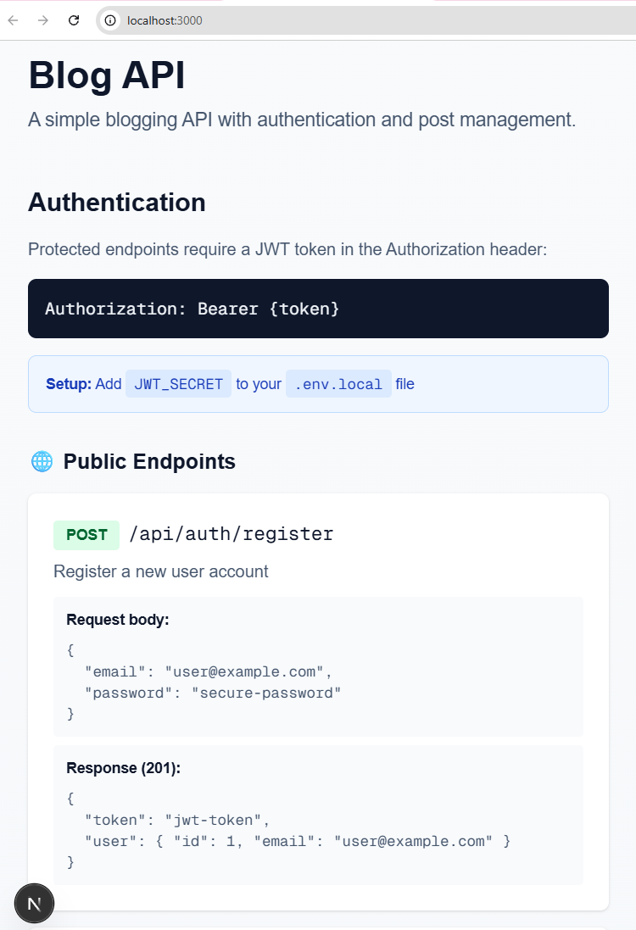
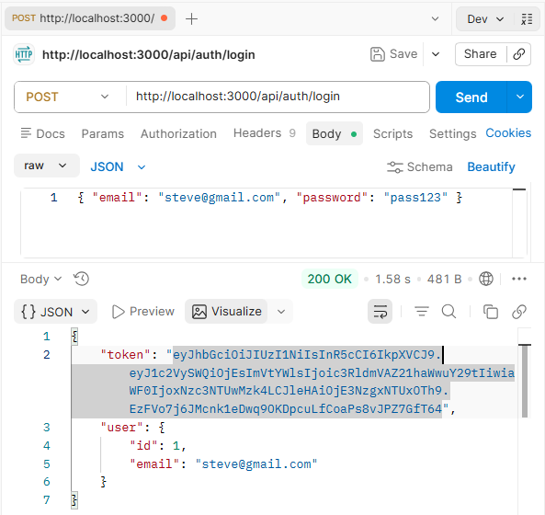
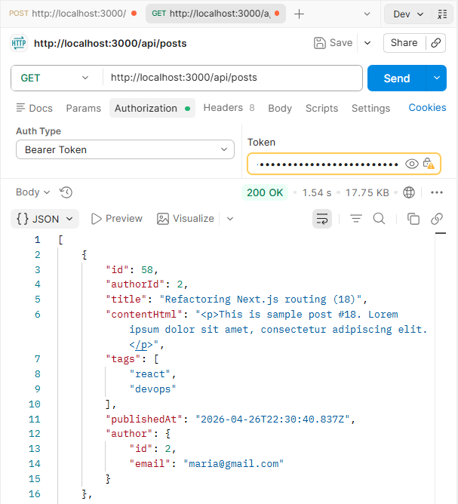
Exercise: Blog System API
RESTful API with Next.js + Drizzle + Neon DB + Users and JWT Authentication

Slide 42
Blog System: Features
Let's build a Blog System API with Next.js + Drizzle + Neon
👤 Anonymous visitors
Browse all published posts
Read full post details
Register an account
✍️ Registered users
Login / logout
Create their own blog posts
Edit / delete only their own posts
🔐 Security
Protected by JWT authentication
Tokens issued on login, verified per request
Passwords hashed with bcrypt

Slide 43
Blog System: Data Model
🗄️Database tables:
Users: id, email (unique), passwordHash
Posts: id, authorId, title, contentHtml, tags[], publishedAt
🔗 Table relations:
One user → many posts
Each post belongs to exactly one user

Slide 44
Blog System: API Endpoints
🌐 Public (no auth)
POST /api/auth/register
POST /api/auth/login
GET /api/posts
GET /api/posts/:id
🔐 Protected (JWT required)
GET /api/auth/me
POST /api/posts
PATCH /api/posts/:id
DELETE /api/posts/:id

Slide 45
Blog System: Steps to Build
Steps to build the Blog System API:
Create a new VS Code project and initialize Next.js and install npm packages for Drizzle + Neon driver
Create DB in Neon, configure Neon MCP, create AGENTS.md
Create DB schema: Drizzle schema → DB migration → apply to DB
Seed sample date in the database
Implement the Blog API as Next.js API
Test the API with Postman

Slide 46
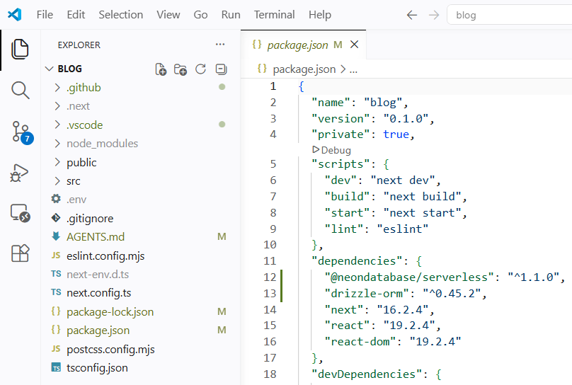
Step 1: Create Next.js Project
Create a new VS Code project
Initialize Next.js project with TypeScript
Install npm packages for Drizzle + Neon driver
Initialize a new Next.js project with TypeScript.
Install npm packages for Drizzle + Neon driver.

Slide 47
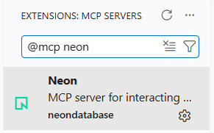
Step 2: Create the Neon DB
Install and configure Neon MCP
Install `@mcp neon` in VS Code
Specify the Neon DB name in AGENTS.md
Use AI prompt in Neon MCP to create a new Neon project `BlogDB`
Or use the Neon console
Save the DATABASE_URL to .env
Verify that Neon MCP can connect to BlogDB
AGENTS.md
# Neon MCP Database Access Rules
- Connect Neon MCP only to a database project named `BlogDB` in my Neon account
Create a new Neon project called "BlogDB" in my account.
Save the DATABASE_URL in a the `.env` file.

Slide 48
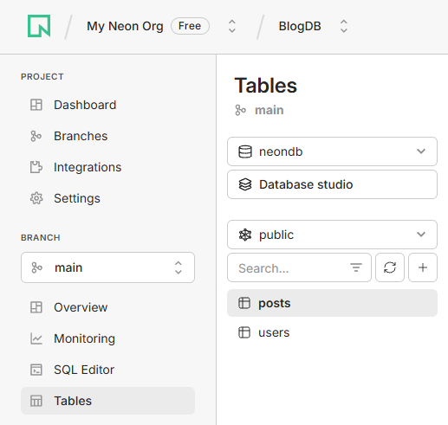
Step 3: Generate DB Schema
🤖 AI prompt to generate DB schema in Neon (with migration):
Configure Drizzle ORM with the Neon serverless driver.
Define a DB schema in my Neon DB:
- users (id, email unique, passwordHash)
- posts (id, authorId FK, title, contentHtml, tags text[], publishedAt)
Generate the initial Drizzle migration.
Run "drizzle-kit migrate" (apply pending migrations to BlogDB).

Slide 49
Step 4: Seed Sample Data
🤖 AI prompt to seed sample data in the DB:
▶️ Run with:
✅ Verify via Neon MCP or from Neon Dashboard
Create a npm script `db:seed` to seed sample data in the DB:
- 2 users: steve@gmail.com, maria@gmail.com, password `pass123` (bcrypt-hashed)
- 30 blog posts with meaningful content: split between the users
- Tags for each post (2-4 tags)
Run the script to populate the DB.
npm run db:seed

Slide 50
Step 5: Implement API Endpoints
🤖 AI prompt to implement API endpoints in Next.js
Implement the Blog API endpoints:
🌐 Public (no auth):
- POST /api/auth/register, /api/auth/login
- GET /api/posts, /api/posts/:id
🔐 Protected (JWT auth)
- GET /api/auth/me
- POST /api/posts
- PATCH /api/posts/:id
- DELETE /api/posts/:id
- Implement paging when retirieving posts.
- Use bcrypt to hash the passwords in the DB.
- Use JWT tokens for authentication.
- Put a random JWT_SECRET in `.env`
- Generate short API docs at the app home page.

Slide 51
The Blog API in Action

Slide 52
Testing the API Manually
Testing the Blog API with Postman / curl
POST http://localhost:3000/api/auth/login
Content-Type: application/json
{ "email": "steve@gmail.com", "password": "pass123" }
GET http://localhost:3000/api/posts
Authorization: Bearer eyJhbGci...
→ 200 OK
{ "posts": […]}
→ 200 OK
{ "token": "eyJhbGciOiJIUzI1NiIs..." }

Slide 53
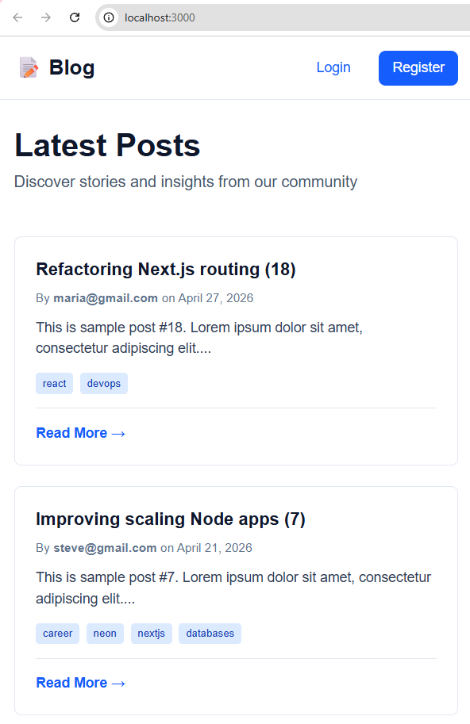
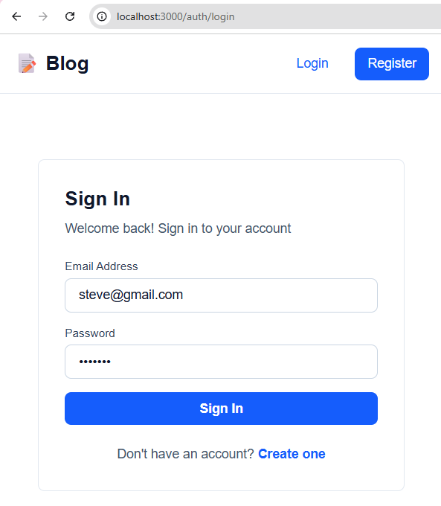
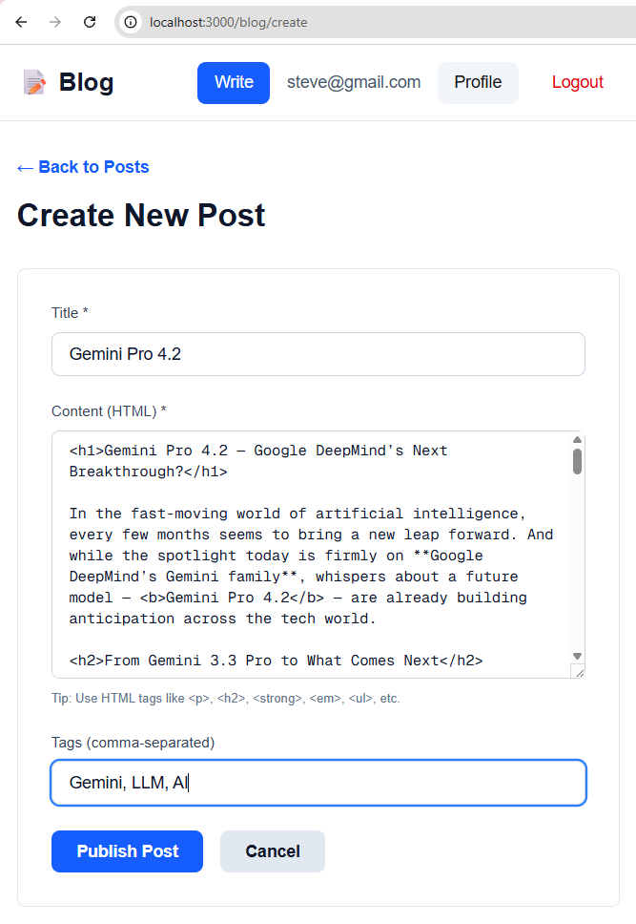
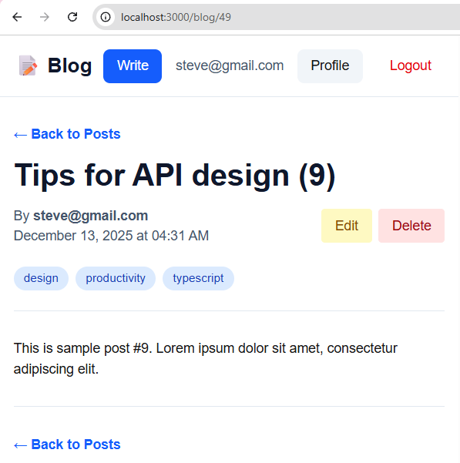
Blog System: Client App
Next.js API + React Front-End + Neon DB + Auth State

Slide 54
Blog System: Client App
Implement a simple Blog app using the Blog System API:
- Anonymous users can view posts (short version, paginated), view post details (full content), register / login (separate pages)
- Registered users (after login) can create posts (publish new content), edit / delete posts (only their own posts), view profile page (own account)
- Share the existing Next.js app for both API and UI
- Style the UI with Tailwind
- Implement a shared layout with header (nav + auth status) + footer
- Structure the app UI into modular components (pages and components) to avoid large complex code
- Show proper loading + error states

Slide 55
Blog System: Client App – Demo

Slide 56
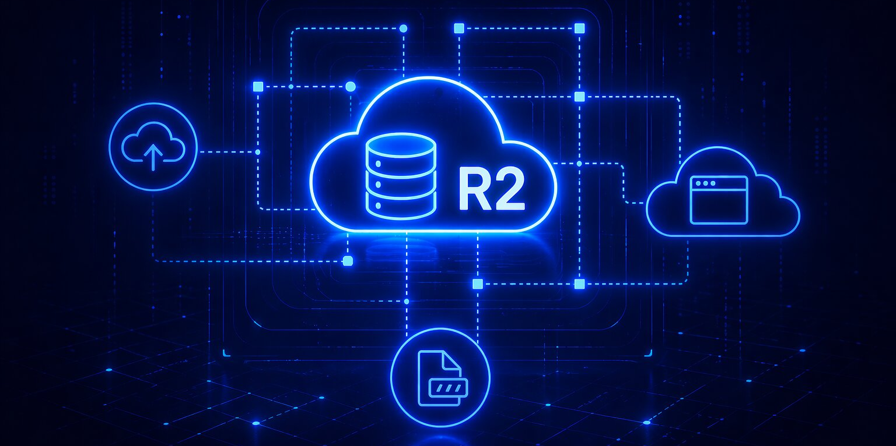
File Uploads in Cloudflare R2
S3-Compatible Object Storage, Cloudflare R2, API Keys, Public URLs

Slide 57
Why Do We Need File Storage?
Modern apps need file storage to keep:
Public file / image uploads, e.g. cover images in a blog
Private documents, videos, files, e.g. financial reports
Where to keep file uploads?
In the file system → works for server-based deployments, less scalable, additional server load, harder to backup
In the database (antipattern) → don't save large objects in the DB, save metadata only (to avoid loads and slow downs)
In object storage service (the modern way) → scalable, fast, efficient, uses CDN, less server load, easier to backup

Slide 58
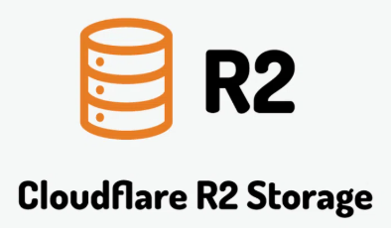
What is Cloudflare R2?
Cloudflare R2 == Cloudflare's object storage service
S3-compatible API (works with AWS SDK)
No egress fees (download traffic is free): huge advantage over AWS S3
Global edge network (330+ data centers worldwide)
Generous free tier: 10 GB storage, 1M Class A ops / month
Ideal for: images, videos, file downloads, backups
Alternatives: AWS S3, Supabase Storage, Backblaze B2, Vercel Blob, Digital Ocean Spaces, Hetzner Object Storage

Slide 59
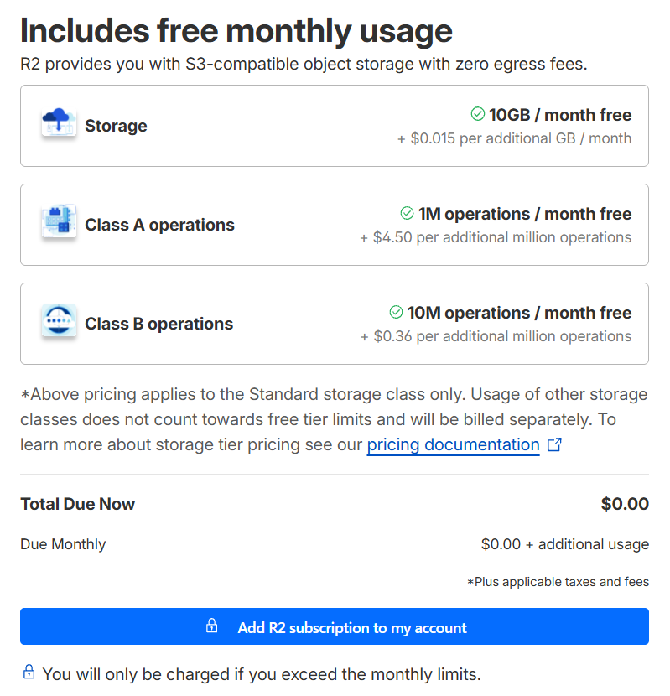
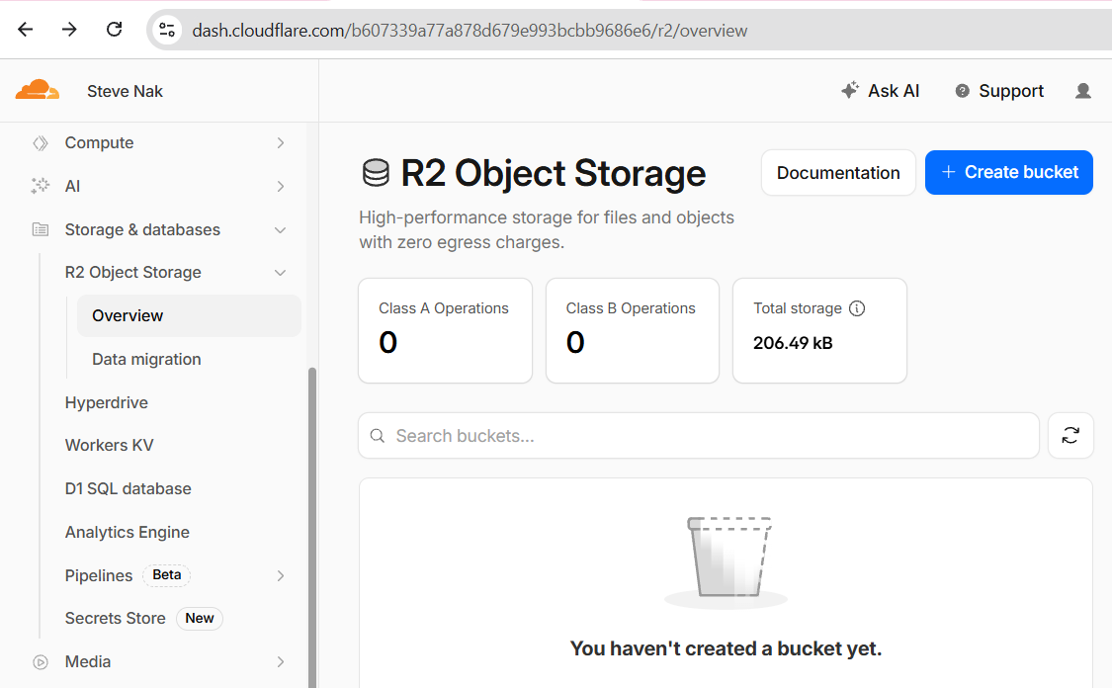
Setting Up Cloudflare R2
Sign up at https://cloudflare.com
Enable R2 → needs a bank card
You can issue a new Revolut virtual card, subscribe, then block the card

Slide 60
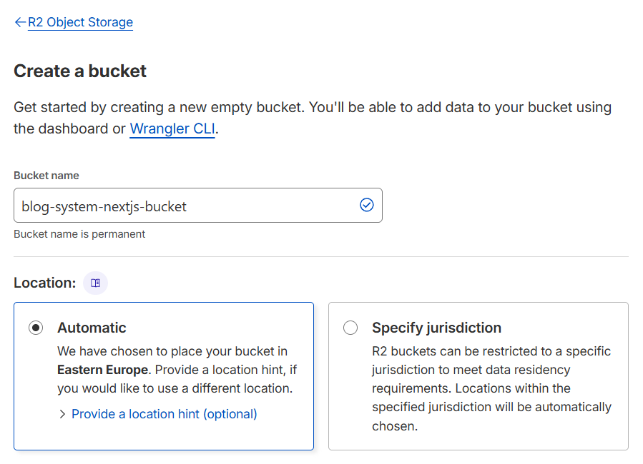
Cloudflare R2: Create a Bucket
Dashboard → Storage and Databases → R2 Object Storage → Create bucket
Name: blog-system-nextjs
Location: Automatic
Create API token
Put the R2 config in .env

Slide 61
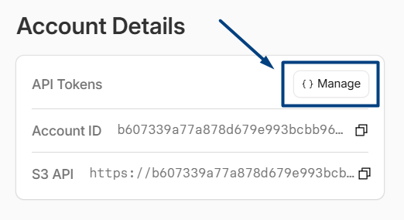
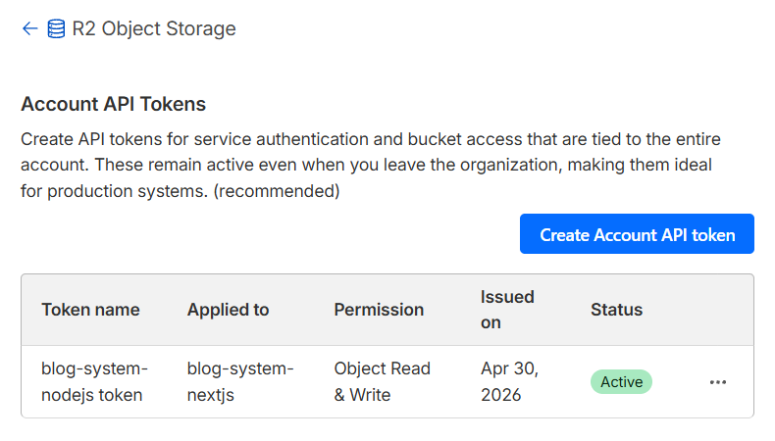
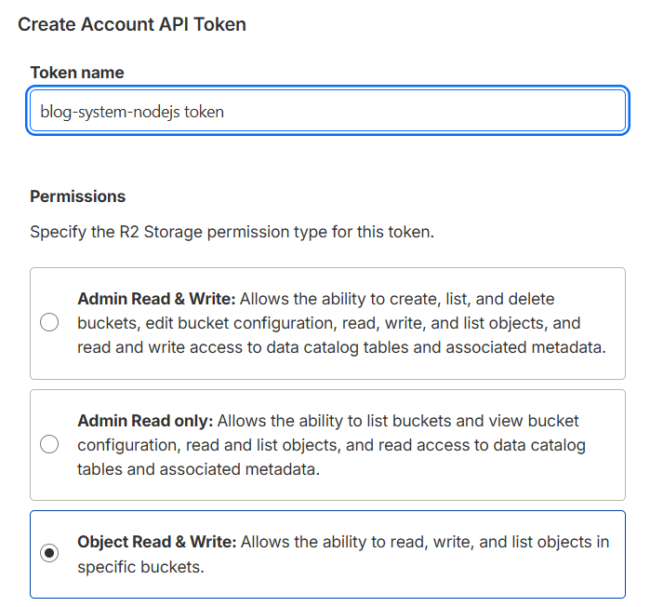
Cloudflare R2: Create API Token
Create API token to access your storage account:

Slide 62
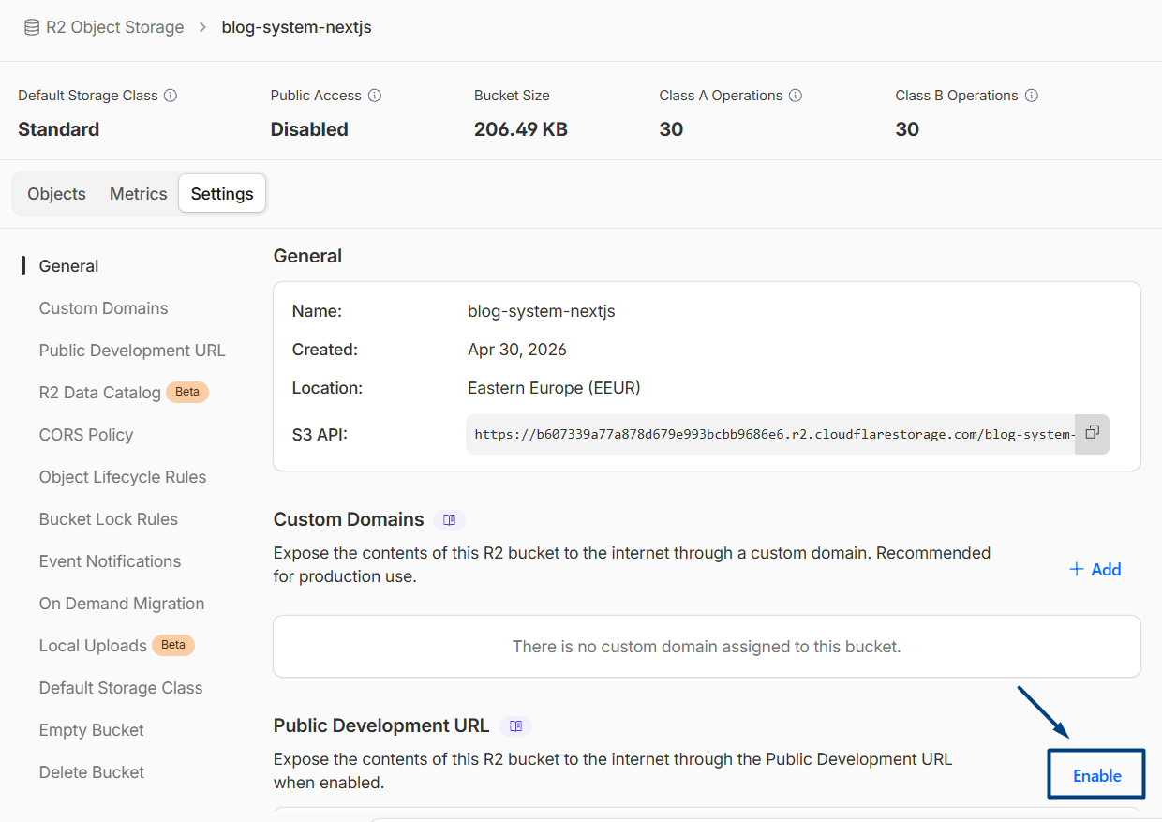
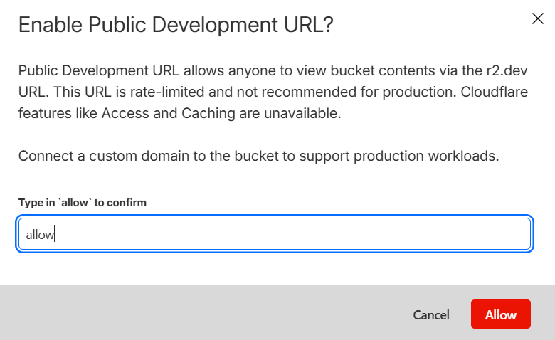
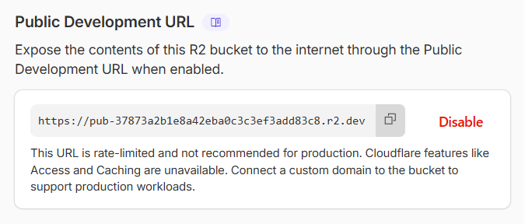
Cloudflare R2: Create API Token
Enable public URL (expose all your files online, unrestricted):

Slide 63
Cloudflare R2: App Config Settings
Save the R2 configuration in `.env`
R2_URL=https://<account_id>.r2.cloudflarestorage.com
R2_BUCKET=blog-system-nextjs
R2_PUBLIC_URL=https://pub-<url-id>.r2.dev
R2_ACCESS_KEY_ID=<s3-access-key-id>
R2_SECRET_ACCESS_KEY=<s3-secret-access-key>

Slide 64
Uploading Files via the AWS SDK
R2 supports the S3 API
Install the AWS SDK v3
Configure an S3Client with R2 endpoint
PutObjectCommand uploads a file
Set the right Content-Type for the MIME
const s3 = new S3Client({ region: "auto",
endpoint: process.env.R2_URL,
credentials: {
accessKeyId: process.env.R2_ACCESS_KEY_ID!,
secretAccessKey: process.env.R2_SECRET_ACCESS_KEY!,
},
});
npm install @aws-sdk/client-s3
await s3.send(new PutObjectCommand({
Bucket: process.env.R2_BUCKET,
Key: "covers/post-42.jpg",
Body: fileBuffer,
ContentType: "image/jpeg",
}));

Slide 65
Step-by-Step – Cover Image Uploads
🤖 AI prompt to implement cover image upload in the Blog:
Implement cover-image uploads to the Blog System:
- Add a coverImageUrl column to posts table
(generate Drizzle migration + Drizzle migrate DB)
- New endpoint POST /api/upload → upload a binary file
- Upload the file to Cloudflare R2 using @aws-sdk/client-s3
- Use R2 credentials from .env
- Return the public URL of the uploaded file
- In the client app UI in the Create / Edit Post pages:
- Add an image upload input with live preview + [Remove] button
- Upload / delete the image on save; remove image on delete post

Slide 66

Automated Testing
Unit Tests, Integration Tests, Jest, Playwright E2E

Slide 67
Automated Testing
What is software testing?
Checks if the app / component behaves as expected
Automated testing
Testing scripts (code) that test the software functionality automatically
Repeatable: catch regressions early, refactor with confidence
Document the expected behavior
Auto-run on repo push: CI / CD pipeline
In AI-first development:
The AI writes tests alongside the code
Tests become the spec for the next AI iteration
Broken tests → the AI self-corrects
Increase software quality

Slide 68
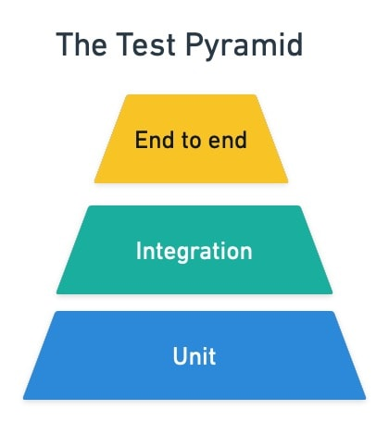
The Test Pyramid
Unit tests – fast, isolated, lots of them
Test a single function / class, no DB, no network
Integration tests – test how multiple components work together
Test with real DB, real HTTP, but local
End-to-end (E2E) tests – slow, realistic
Full app in a real browser – high value
Rule of thumb: many unit, some integration, few E2E

Slide 69

Jest: Intro
Jest == popular, modern JS testing framework
https://jestjs.io
🚀 Fast test runner with parallel execution
📦 Built-in assertions and mocking
🔷 Works with TypeScript (via ts-jest)
📊 Code coverage reports
⚛️ Integrates well with Next.js
# Install Jest
npm install -D jest
# Install Jest with TypeScript support
npm install -D jest ts-jest @types/jest
# Run tests
npx jest
# Code coverage
npx jest --coverage

Slide 70
Jest: First Unit Test
// lib/slug.ts
export function slugify(s: string) {
return s.toLowerCase().replace(/\s+/g, "-");
}
// lib/slug.test.ts
import { slugify } from "./slug";
describe("slugify", () => {
it("lowercases and hyphenates", () => {
expect(slugify("Hello World")).toBe("hello-world");
});
});

Slide 71

Blog API: Implement Unit Tests
🤖 AI prompt to implement unit tests with Jest:
Implement automated Jest unit tests for the Blog System API.
Mock external dependencies (DB, network).
Run the tests and measure code coverage.

Slide 72

Measure Code Coverage

Slide 73
Blog API: Integration Tests
🤖 AI prompt to implement integration tests with Jest:
Implement integration tests with Jest for the Blog System API
- Work in a testing Neon database (connect by TEST_DATABASE_URL), not a mocked database
- Test with real HTTP requests (not mocked)
- Testing workflow: connect to test DB, run Drizzle migrate, empty all DB tables, seed testing data, run the integration tests
- Test all major endpoints: register, login, me, list, view, create, edit, delete posts, non-owner forbidden , …

Slide 74

Playwright: E2E Testing
Playwright == browser automation framework
Headless browser: Chromium, Firefox, WebKit
Auto-waits for elements to load before interaction
Record screenshots + videos on failure
Parallel test execution
https://playwright.dev
# Install Playwright
npm install playwright@latest

Slide 75
Playwright – Sample Test Code
import { test, expect } from "@playwright/test";
test("user can log in and create a post",
async ({ page }) => {
await page.goto("/auth/login");
await page.fill('input[name="email"]',
"alice@test.com");
await page.fill('input[name="password"]', "1234");
await page.click('button[type="submit"]');
await expect(page).toHaveURL("/");
await page.click("text=New Post");
// ... fill title/content, click Publish
await expect(page.locator("h1"))
.toContainText("Hello Playwright");
});

Slide 76
Blog Client: E2E Tests with Playwright
🤖 AI prompt to implement end-to-end tests with Playwright:
Implement Playwright end-to-end tests for the Blog client:
- Home page renders the expected number of posts
- Register + login flow works
- A logged-in user can create, edit, delete a post
- A non-owner cannot see [Edit] / [Delete] on someone else's post
Run against local dev server with a fresh seeded testing DB.

Slide 77

E2E Tests with Playwright – Demo
Run the Playwright tests (headless):
playwright test
Run the Playwright tests (with a visible browser):
playwright test --headed

Slide 78

Serverless vs. Server-Based Deployment
Cloud Providers, Trade-offs, Choosing the Right Platform

Slide 79
Server-Based vs. Serverless
🖥️ Server-based
Rent a VM / container running 24/7
Predictable performance, full control
Pay even when idle
Providers:
Digital Ocean, Heroku, Render, Railway, AWS EC2
⚡ Serverless
Platform runs code on demand
Scales to zero, pay per request
Cold starts possible
Providers:
Vercel, Netlify, Cloudflare Workers, AWS Lambda

Slide 80
When to Pick Which?
⚡ Serverless is great for
Low / spiky traffic - pay only per request
APIs, sites, webhooks - short-lived requests
Startups / MVPs - scale without ops
Edge delivery - global low-latency
🖥️ Server-based is great for
Long-running jobs - no timeout limits
WebSockets - persistent connections
Heavy, sustained traffic - cheaper at scale
Stateful workloads - local disk / memory

Slide 81
Popular Cloud Providers
🖥️ Server-based
Digital Ocean: simple VPS + App Platform
Render: Heroku alternative, easy PaaS
Railway: deploy from Git, great dev experience
AWS EC2 / ECS: industry standard, expensive
⚡ Serverless
Vercel: built for Next.js
Netlify: great for static + functions, works for Next.js
Cloudflare Workers: edge-first, ultra-fast
AWS Lambda: most mature, huge ecosystem

Slide 82

Deploying Next.js to Netlify
GitHub Integration, Env Variables, Production Database

Slide 83

Netlify: Serverless Hosting Platform
Netlify == serverless hosting for front-end projects
Register at: https://netlify.com
Supports Next.js apps
Connects to your Git repo
Auto-deploys on every push
Preview deploys per pull request
Free tier is generous for small projects
Built-in CDN, HTTPS, custom domains

Slide 84

Prepping the Project
# .env — keep all secrets here
DATABASE_URL=postgresql://...
JWT_SECRET=<random-32-bytes>
R2_URL=…
R2_BUCKET=…
R2_ACCESS_KEY_ID=…
R2_SECRET_ACCESS_KEY=…
R2_PUBLIC_URL=…
# Add .env to .gitignore
# Keep .env.example with empty values

Slide 85

Step 1: Push to GitHub
🤖 Use AI prompt or the Git UI in VS Code:
Initialize a git repo for this project:
- Create a `.gitignore` for Node + Next.js
- Commit the code in the local Git
- Create a GitHub repo "blog-system-nextjs" (private)
- Push the code to GitHub

Slide 86

Step 2: Connect Netlify to GitHub
Netlify.com → Add new site → Import from Git
Select GitHub → authorize the Netlify app
Pick the repo blog-system-nextjs
Netlify auto-detects Next.js:
Build command: next build
Publish directory: .next

Slide 87


Step 3: Configure Environment Variables
Add all vars from .env
Netlify → Site settings → Environment variables

Slide 88

Step 4: Test the Deployed App
Netlify gives you a URL: https://<name>.netlify.app
Smoke tests to run:
Home page loads posts
Register + login works
Create post + image upload works
DB queries hit the Neon production branch
Check build + function logs for errors

Slide 89

Watch for Errors in Netlify Logs

Slide 90
Lesson Summary
Neon: serverless PostgreSQL with Git-like branches
Drizzle ORM: TypeScript-first, → lightweight, serverless-friendly, auto migrations (schema → create migration → migrate)
Next.js: API + UI in one framework, ideal for AI-assisted dev
JWT + bcrypt: classic stateless authentication in APIs
Cloudflare R2: file storage, S3-compatible, no egress fees
Jest + Playwright: unit + integration + E2E testing in TS
Netlify: push to Git → configure env → deploy Next.js

Slide 91
Questions?

Slide 92


SoftUni AI Exclusive Partner
One of the leading banking institutions in Bulgaria, part of Eurobank Group
Innovative leader in next-generation banking
Beyond Banking – the new standard for a complete customer experience beyond traditional banking
AI integration for business, learning and development
AI Assistants for talents: Story Builder, CV Assistant, Interview Trainer
Internationally certified Top Employer 2026 by the Top Employers Institute
Commitment to people and wellbeing initiatives - additional benefits, professional, personal, and leadership trainings
Take your course, pay in installments, remotely in minutes. Learn more HERE
Explore career opportunities: www.careers.postbank.bg

Slide 93






SoftUni Diamond Partners

Slide 94






Diamond Partners of SoftUni Digital

Slide 95




Organization Partners of SoftUni Creative

Slide 96

License
This course (slides, examples, code, demos, exercises, tutorials, homework, projects, documents, videos and other assets) is copyrighted content, created by SoftUni
Unauthorized copy, reproduction or use is illegal
© SoftUni – https://softuni.bg
© SoftUni AI – https://ai.softuni.bg

Slide 97



Trainings @ SoftUni AI
SoftUni AI: a comprehensive learning program for applying AI in business and everyday life
ai.softuni.bg
SoftUni AI @ Facebook
facebook.com/SoftUniAI
SoftUni AI @ YouTube
youtube.com/@SoftUniAI

